Slide 1
RISC-V Procedures
Slides: PDF

Slide 2
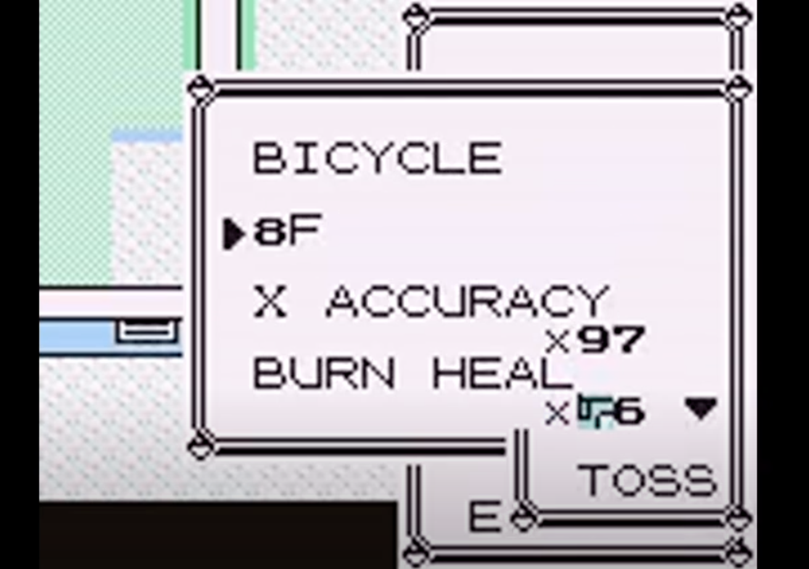

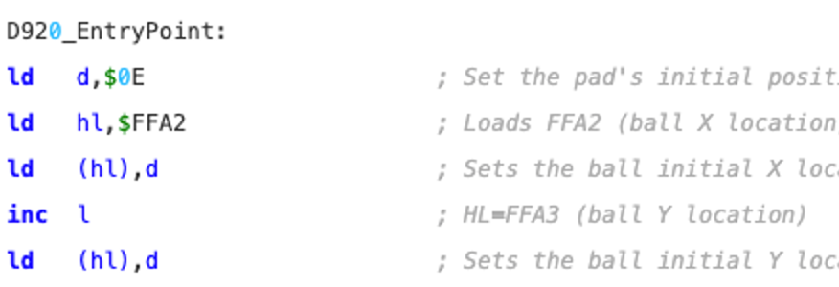
Computing in the News: Hacking Pokemon into Pong
“8F is an item executing machine code from $D163 (Number of Pokemon) upon use."
An exploit that lets you change the program counter
Instructions are bytes in memory!
Write executable code by navigating the world and moving around items.
YouTube, Zilog Z80

Slide 3
Function Calls

Slide 4
[warmup] From Lab 03: Review + New Concepts
0x 0
4
8
…
20
24
28
…
48
4c
50
54
58
5c
60
64
main:
li a0 4
jal ra factorial
addi a1 a0 0
…
li a0 3
jal ra factorial
addi a1 a0 0
…
factorial:
addi t0 x0 1
addi t1 x0 1
loop:
bgt t0 a0 done
mul t1 t1 t0
addi t0 t0 1
j loop
done:
add a0 t1 x0
jr ra
— review —
Why do instruction addresses increment by 4 bytes?
What is the analogous C function factorial()?
— new —
What is the instruction that
Calls (“invokes”) factorial()?
Returns from factorial()?
Which register holds
the argument to factorial()?
the return value of factorial()?

Slide 5
[Review] From Lab 03
0x 0
4
8
…
20
24
28
…
48
4c
50
54
58
5c
60
64
main:
li a0 4
jal ra factorial
addi a1 a0 0
…
li a0 3
jal ra factorial
addi a1 a0 0
…
factorial:
addi t0 x0 1
addi t1 x0 1
loop:
bgt t0 a0 done
mul t1 t1 t0
addi t0 t0 1
j loop
done:
add a0 t1 x0
jr ra
Why do instruction addresses increment by 4 bytes?
What is the analogous C function factorial()?
RV32I instructions are 32b wide, stored in the text segment.
pc register: the program counter holds the address of the current instruction.
int factorial(int n) {
int prod = 1;
for (int i = 1; i <= n; i++) {
prod *= i;
}
int retval = prod;
return retval;
}
a0
<n, retval>
t0
<i>
t1
<prod>

Slide 6
[New] From Lab 03
0x 0
4
8
…
20
24
28
…
48
4c
50
54
58
5c
60
64
main:
li a0 4
jal ra factorial
addi a1 a0 0
…
li a0 3
jal ra factorial
addi a1 a0 0
…
factorial:
addi t0 x0 1
addi t1 x0 1
loop:
bgt t0 a0 done
mul t1 t1 t0
addi t0 t0 1
j loop
done:
add a0 t1 x0
jr ra
3. What is the instruction that
Calls (“invokes”) factorial()?
Returns from factorial()?
jal ra factorial
jr ra
ra (return address) is a register name for register x1.

Slide 7
[review] Jumps
In C, run code one line at a time.
Usually the line immediately afterwards…
But control flow syntax creates structures that “jump” to other lines of code.
1
2
3
4
5
6
7
…
10
11
12
13
int foo(n) {
int a = 5;
if (n > 5) {
a += 1;
}
return a+n;
}
...
line;
foo(5);
line;
foo(7);
conditional jump
(otherwise)
Function calls:
Unconditional jumps
pc register updates to something other than current + 4
Line to return to depends on where function call occurred
unconditional jump

Slide 8
jal: Call a Function, jr: Return from a Function
Jump and link
jal rd Label
Jump register (pseudo)
jr rs1
R[rd] = PC + 4
PC = <address of Label>
Means:
Set register rd to PC + 4
Unconditional jump: go to statement labeled Label
PC = R[rs1]
Means:
Unconditional jump: goto statement at address R[rs1]
Pseudoinstruction
Common instruction pair:
jal ra FunctionName
jr ra
ra (return address) is a register name for register x1.

Slide 9
jal, jr in action
0x 0
4
8
…
20
24
28
…
48
4c
50
54
58
5c
60
64
main:
li a0 4
jal ra factorial
addi a1 a0 0
…
li a0 3
jal ra factorial
addi a1 a0 0
…
factorial:
addi t0 x0 1
addi t1 x0 1
loop:
bgt t0 a0 done
mul t1 t1 t0
addi t0 t0 1
j loop
done:
add a0 t1 x0
jr ra
Function call: jal @ 0x4
0x4
0x48
pc
0x4
0xABCD ABCD
0x8
ra
0xABCD ABCD
Function return: jr @ 0x64
0x64
0x8
pc
0x64
ra
0x8
Function call: jal @ 0x24
0x24
0x48
pc
0x24
0xA
0x28
ra
0xA
Function return: jr @ 0x64
0x64
0x28
pc
0x64
ra
0x28

Slide 10
Four common jump instructions/pseudoinstructions
Jump and link
jal rd Label
Jump register (pseudo)
jr rs1
R[rd] = PC + 4
PC = <address of Label>
PC = R[rs1]
Translation: jalr x0 rs1 0
Jump and link register
jalr rd rs1 imm
Jump (pseudo)
j Label
R[rd] = PC + 4
PC = R[rs1] + imm
Means:
Less common than other jumps
Higher-order fns, some function calls (more later)
PC = <address of Label>
Means:
Unconditional jump, e.g., for loops (from last time)
Translation: jal x0 Label

Slide 11
[New] From Lab 03, Last Part
0x 0
4
8
…
20
24
28
…
48
4c
50
54
58
5c
60
64
main:
li a0 4
jal ra factorial
addi a1 a0 0
…
li a0 3
jal ra factorial
addi a1 a0 0
…
factorial:
addi t0 x0 1
addi t1 x0 1
loop:
bgt t0 a0 done
mul t1 t1 t0
addi t0 t0 1
j loop
done:
add a0 t1 x0
jr ra
4. Which register holds
the argument to factorial()?
the return value of factorial()?
int factorial(int n) {
int prod = 1;
for (int i = 1; i <= n; i++) {
prod *= i;
}
int retval = prod;
return retval;
}
a0
<n, retval>
t0
<i>
t1
<prod>
a0 is a register name for register x10 and is used for both
the first argument to a function, and
the return value of a function.

Slide 12
RISC-V Calling Convention, Part 1 of 3
Registers faster than memory, so use them!
Register names provide conventions for calling functions, passing in arguments, and returning from functions.
a0–a7 (x10-x17):
eight argument registers to pass parameters
two return values (a0-a1), though we usually use a0
ra (x1):
one return address register to return to the point of origin
More later: stack pointer, saved registers, temporary registers
Different functions share the same set of registers and use them with the same calling conventions.

Slide 13
Stack Frames

Slide 14
Fundamental Steps in Calling a Function
Set up arguments
Transfer control to function
Prologue
Perform desired function task
Epilogue
Return control to point of origin
Put arguments in a0, …, a7, etc.
jal ra fnLabel
Acquire (local) storage resources needed for function: stack, registers
Put return value a0 (or a1)
Restore any registers used
Release local storage on stack
j ra

Slide 15
[Review] C Stack Frames
int main ()
{ a(0); …
}
sp
stack
0xFFFF FFFF
main
void a (int m)
{ b(1);
}
sp
a
void b (int n)
{ c(2);
}
sp
b
The stack grows downward; a()’s local variables have lower byte addresses than main()’s, and so on.
void c (int o)
{ d(3);
}
sp
c
sp
void d (int p)
{
}
d
The stack pointer (sp) is what determines “allocating” and “deallocating/freeing” stack frames!
sp
[animate this slide]
0x0000 0000

Slide 16
RISC-V Stack
RISC-V stack frames (mostly) operate like C stack frames.
Stack pointer register: sp (x2)
A function can choose to use a stack frame by manipulating sp:
After a function is called, create stack frame/decrement sp.
When function wraps up, delete stack frame/increment sp.
Stack frame can include:
Space for local variables (e.g., stack arrays)
Return “instruction” address (why?)
Parameters (arguments) beyond the 8 argument registers
Not all RISC-V functions need stack frames. Some functions only need registers! (see earlier example)

Slide 17
The RISC-V Stack Also Grows Down
0x 0
4
…
…
…
20
24
28
…
50
54
…
70
…
main:
addi sp sp -12
…
# x calls fooA
…
addi sp sp 12
j exit
fooA:
addi sp sp -8
…
addi sp sp 8
jr ra
…
exit:
…
 | +3 | +2 | +1 | +0
0xFFFF FFDC
0xFFFF FFD8
0xFFFF FFD4
0xFFFF FFD0 | 0xB0BA CAFE
0xFFFF FFCC | 0xABCD EF12
0xFFFF FFC8 | 0x3456 7890
0xFFFF FFC4 | 0xB0BA CAFE
0xFFFF FF | 0xABCD EF12
“main’s” stack frame
sp
0xFFFF FFD4
“main’s” stack pointer

Slide 18
The RISC-V Stack Also Grows Down
0x 0
4
…
…
…
20
24
28
…
50
54
…
70
…
main:
addi sp sp -12
…
# x calls fooA
…
addi sp sp 12
j exit
fooA:
addi sp sp -8
…
addi sp sp 8
jr ra
…
exit:
…
 | +3 | +2 | +1 | +0
0xFFFF FFDC
0xFFFF FFD8
0xFFFF FFD4
0xFFFF FFD0 | 0xB0BA CAFE
0xFFFF FFCC | 0xABCD EF12
0xFFFF FFC8 | 0x3456 7890
0xFFFF FFC4 | 0xB0BA CAFE
0xFFFF FF | 0xABCD EF12
“main’s” stack frame
“fooA’s” stack frame
sp
0xFFFF FFCC
“fooA’s” stack pointer

Slide 19
The RISC-V Stack Also Grows Down
0x 0
4
…
…
…
20
24
28
…
50
54
…
70
…
main:
addi sp sp -12
…
# x calls fooA
…
addi sp sp 12
j exit
fooA:
addi sp sp -8
…
addi sp sp 8
jr ra
…
exit:
…
 | +3 | +2 | +1 | +0
0xFFFF FFDC
0xFFFF FFD8
0xFFFF FFD4
0xFFFF FFD0 | 0xB0BA CAFE
0xFFFF FFCC | 0xABCD EF12
0xFFFF FFC8 | 0x3456 7890
0xFFFF FFC4 | 0xB0BA CAFE
0xFFFF FF | 0xABCD EF12
“main’s” stack frame
“fooA’s” stack frame
sp
0xFFFF FFD4
Restore caller’s (here, main’s) stack pointer before “returning”

Slide 20
The RISC-V Stack Also Grows Down
0x 0
4
…
…
…
20
24
28
…
50
54
…
70
…
main:
addi sp sp -12
…
# x calls fooA
…
addi sp sp 12
j exit
fooA:
addi sp sp -8
…
addi sp sp 8
jr ra
…
exit:
…
 | +3 | +2 | +1 | +0
0xFFFF FFDC
0xFFFF FFD8
0xFFFF FFD4
0xFFFF FFD0 | 0x0000 0001
0xFFFF FFCC | 0x0000 FACE
0xFFFF FFC8 | 0x3456 7890
0xFFFF FFC4 | 0xB0BA CAFE
0xFFFF FF | 0xABCD EF12
“main’s” stack frame
sp
0xFFFF FFD4
When main “has control,” it sees the right stack pointer

Slide 21
RISC-V Calling Convention, Part 2 of 3
Registers faster than memory, so use them!
Use stack frames sparingly!
Different functions share the same set of registers and use them with the same calling conventions.
a0–a7 (x10-x17):
eight argument registers to pass parameters
two return values (a0-a1), though we usually use a0
ra (x1):
one return address register to return to the point of origin
sp (x2):
stack pointer has address of bottom of stack (current stack frame)
new

Slide 22
RISC-V Calling Convention, Part 3 of 3
Registers faster than memory, so use them!
Use stack frames sparingly!
Different functions share the same set of registers and use them with the same calling conventions.
a0–a7 (x10-x17):
eight argument registers to pass parameters
two return values (a0-a1), though we usually use a0
ra (x1):
one return address register to return to the point of origin
sp (x2):
stack pointer has address of bottom of stack (current stack frame)
s0–s11 (x8,x9,x18-x27): Saved registers
t0–t6 (x5-x7,x28-x31): Temporary registers
?????

Slide 23
RISC-V Calling Convention

Slide 24
❌ Clobbered Registers with Nested Function Calls
Suppose we implement a recursive factorial function.
Below, what is the issue with factorial(2)?
// assume non-negative numbers
int factorial(int n) {
if (n == 1) return 1;
int a = n*factorial(n-1);
return a;
}
Caller factorial(2)’s perspective:
Prepare for callee factorial(1) by passing in new argument, 1
Pass control to callee factorial(1)
Multiply callee’s return value by multiplying by original argument, 2
Return result
pc
0x4
ra
0x8
Argument, return value
a0
2
Because all functions use the same RISC-V calling convention, register values can get clobbered with nested function calls.

Slide 25
Register Calling Conventions
CalleR: the calling function
CalleE: the function being called
When callee returns from executing, the caller needs to know:
Which registers may have changed, and
Which are guaranteed to be unchanged.
Register calling conventions: A set of generally accepted rules as to which registers will be unchanged after a procedure call (jal) and which may be changed.
To reduce expensive loads and stores from spilling and restoring registers, RISC-V function-calling convention divides registers into two categories:
Not preserved across function call
Are preserved across function call (if the callee changed any registers, it restored original values before returning)

Slide 26
Caller-saved vs. Callee-saved registers
Caller-saved:
Return address, ra
Temporary registers, t0-t6
Arguments/retvals, a0-a7
Callee-saved:
Stack pointer, sp
Saved registers, s0-s11
Should be preserved across function call!
Callee is responsible for
Saving/restoring these registers values in the function prologue, and epilogue, respectively
Allocating/deallocating the stack frame.
May not be preserved across function call!
Caller is responsible for
Saving these register values for itself before calling a callee
Caller: To save register values, save to s0-s11 or to your stack frame.
Callee: To save register values, make space in your stack frame.

Slide 27
Fundamental Steps in Calling a Function: CALLER
Set up for callee
Transfer control to callee
Prologue
Perform desired function task
Epilogue
Return control to point of origin
Save caller-saved registers if needed, either by copying to s0-s11 or to stack
Put arguments in a0, …, a7, stack, etc.
a
a
jal ra fnLabel
a
j ra # callee
Restore caller-saved registers if needed

Slide 28
Fundamental Steps in Calling a Function: CALLEE
Set up for callee
Transfer control to callee
Prologue
Perform desired function task
Epilogue
Return control to point of origin
Push stack frame/decrement sp
Save callee-saved registers:
return address, ra
s0-s11
Save pace for local non-register variables (e.g., stack arrays)
a
a
Put return value a0 (or a1)
Restore any caller-saved registers used, including ra
Pop stack frame/increment sp
a
j ra # callee
Restore caller-saved registers if needed

Slide 29
[Venus] Recursive Example
[venus demo, Drive]

Slide 30
(1/7) Recursive Factorial
[venus demo, Drive]
0x 0
4
…
48
4c
50
54
58
5c
60
64
68
6c
70
74
78
7c
80
main:
li a0 3
jal ra factorial
…
factorial:
addi sp sp -8
sw ra 0(sp)
sw s0 4(sp)
mv s0 a0
li t0 1
bne s0 t0 recurse
li a0 1
j epilogue
recurse:
addi a0 s0 -1
jal ra factorial
mul a0 s0 a0
epilogue:
lw ra 0(sp)
lw s0 4(sp)
addi sp sp 8
jr ra
Prologue:
How large is the stack frame?
Which registers get saved to the stack?
0x6c: As caller, what do we save before making the recursive call? Why?
Why do we use the temporary register t0?
Epilogue: Do we restore registers first or pop stack frame?
0x64: Why j epilogue? Why not j ra?
Prologue
Epilogue

Slide 31
(2/7) Recursive Factorial: C Code
[venus demo, Drive]
0x 0
4
…
48
4c
50
54
58
5c
60
64
68
6c
70
74
78
7c
80
main:
li a0 3
jal ra factorial
…
factorial:
addi sp sp -8
sw ra 0(sp)
sw s0 4(sp)
mv s0 a0
li t0 1
bne s0 t0 recurse
li a0 1
j epilogue
recurse:
addi a0 s0 -1
jal ra factorial
mul a0 s0 a0
epilogue:
lw ra 0(sp)
lw s0 4(sp)
addi sp sp 8
jr ra
Set breakpoints:
factorial(4): 0x4
factorial(3): 0x24
factorial: 0x48
Base case: 0x64
Recursive call: 0x6c
Check: registers a0, s0
Prologue
// assume non-negative numbers
int factorial(int n) {
if (n == 1) return 1;
int a = n*factorial(n-1);
return a;
}
Epilogue

Slide 32
(3/7) Recursive Factorial: Question 1
0x 0
4
…
48
4c
50
54
58
5c
60
64
68
6c
70
74
78
7c
80
main:
li a0 3
jal ra factorial
…
factorial:
addi sp sp -8
sw ra 0(sp)
sw s0 4(sp)
mv s0 a0
li t0 1
bne s0 t0 recurse
li a0 1
j epilogue
recurse:
addi a0 s0 -1
jal ra factorial
mul a0 s0 a0
epilogue:
lw ra 0(sp)
lw s0 4(sp)
addi sp sp 8
jr ra
1. Prologue:
How large is the stack frame?
Which registers get saved to the stack?
8B
Prologue
Our ra, because we (may) do a recursive function call
Our caller’s s0
// assume non-negative numbers
int factorial(int n) {
if (n == 1) return 1;
int a = n*factorial(n-1);
return a;
}
Epilogue

Slide 33
(4/7) Recursive Factorial: Question 2
0x 0
4
…
48
4c
50
54
58
5c
60
64
68
6c
70
74
78
7c
80
main:
li a0 3
jal ra factorial
…
factorial:
addi sp sp -8
sw ra 0(sp)
sw s0 4(sp)
mv s0 a0
li t0 1
bne s0 t0 recurse
li a0 1
j epilogue
recurse:
addi a0 s0 -1
jal ra factorial
mul a0 s0 a0
epilogue:
lw ra 0(sp)
lw s0 4(sp)
addi sp sp 8
jr ra
2. 0x6c: As caller, what do we save before making the recursive call? Why?
Copy argument a0 to saved register s0
Need to use s0 after recursive call completes
Prologue
// assume non-negative numbers
int factorial(int n) {
if (n == 1) return 1;
int a = n*factorial(n-1);
return a;
}
Epilogue

Slide 34
(5/7) Recursive Factorial: Question 3
0x 0
4
…
48
4c
50
54
58
5c
60
64
68
6c
70
74
78
7c
80
main:
li a0 3
jal ra factorial
…
factorial:
addi sp sp -8
sw ra 0(sp)
sw s0 4(sp)
mv s0 a0
li t0 1
bne s0 t0 recurse
li a0 1
j epilogue
recurse:
addi a0 s0 -1
jal ra factorial
mul a0 s0 a0
epilogue:
lw ra 0(sp)
lw s0 4(sp)
addi sp sp 8
jr ra
3. Why do we use the temporary register t0?
Base case is 1
Branch instruction compares two registers
Prologue
// assume non-negative numbers
int factorial(int n) {
if (n == 1) return 1;
int a = n*factorial(n-1);
return a;
}
Epilogue

Slide 35
(6/7) Recursive Factorial: Question 4
0x 0
4
…
48
4c
50
54
58
5c
60
64
68
6c
70
74
78
7c
80
main:
li a0 3
jal ra factorial
…
factorial:
addi sp sp -8
sw ra 0(sp)
sw s0 4(sp)
mv s0 a0
li t0 1
bne s0 t0 recurse
li a0 1
j epilogue
recurse:
addi a0 s0 -1
jal ra factorial
mul a0 s0 a0
epilogue:
lw ra 0(sp)
lw s0 4(sp)
addi sp sp 8
jr ra
4. Epilogue: Do we restore registers first or pop stack frame?
Pop stack frame at the very end, right before returning
Prologue
// assume non-negative numbers
int factorial(int n) {
if (n == 1) return 1;
int a = n*factorial(n-1);
return a;
}
Epilogue

Slide 36
(7/7) Recursive Factorial: Question 5
0x 0
4
…
48
4c
50
54
58
5c
60
64
68
6c
70
74
78
7c
80
main:
li a0 3
jal ra factorial
…
factorial:
addi sp sp -8
sw ra 0(sp)
sw s0 4(sp)
mv s0 a0
li t0 1
bne s0 t0 recurse
li a0 1
j epilogue
recurse:
addi a0 s0 -1
jal ra factorial
mul a0 s0 a0
epilogue:
lw ra 0(sp)
lw s0 4(sp)
addi sp sp 8
jr ra
5. 0x64: Why j epilogue? Why not j ra?
When returning, we are always responsible for deallocating our own stack frame!
We must also restore registers:
Restore our ra, since it may have changed if we made a recursive fn call
Restore our caller’s s0, so they can use it
Prologue
// assume non-negative numbers
int factorial(int n) {
if (n == 1) return 1;
int a = n*factorial(n-1);
return a;
}
Epilogue

Slide 37
[Reference] Summary, Other Registers

Slide 38
[Summary] RISC-V So Far
Arithmetic
add
sub
and
or
xor
sll
srl
sra
Immediate
addi
andi
ori
xori
slli
srli
srai
li (pseudo)
Loads/Stores
lw
lb
lbu
sw
sb
Branches/ Jumps
beq
bne
bge
blt
bgeu
bltu
j (pseudo)
jalr
jal
jr (pseudo)

Slide 39
Summary: RISC-V Calling Convention
Registers faster than memory, so use them!
Use stack frames sparingly!
Different functions share the same set of registers and use them with the same calling conventions.
a0–a7 (x10-x17):
eight argument registers to pass parameters
two return values (a0-a1), though we usually use a0
ra (x1):
one return address register to return to the point of origin
Caller-saved
Caller-saved
sp (x2):
stack pointer has address of bottom of stack (current stack frame)
Callee-saved
s0–s11 (x8,x9,x18-x27): Saved registers
t0–t6 (x5-x7,x28-x31): Temporary registers
Callee-saved
Caller-saved

Slide 40
Other Registers
These registers that are out of scope for this class (don't use them!)
gp: The x3 register, used to store a reference to the heap. Also called the "global pointer"
tp: The x4 register, used to store separate stacks for threads
(multithreading covered way later)

Slide 41
[Extra] Recursive Example 2

Slide 42
C code
int foo(int i) {
if (i == 1) return 0;
int a = i + foo(i-1);
return a;
}
int j = foo(3);
int k = foo(100);
int m = j+k;

Slide 43
RISC-V code
j main
foo: # int foo(int i)
addi sp sp -8 # Prologue
sw ra 0(sp) # Prologue
sw s0 4(sp) # Prologue
mv s0 a0 # Move i
bne s0 x0 Next# if i != 0, skip this
li a0 0 # int a = 0;
j Epilogue # Go to Epilogue
# (to restore stack)
Next:
addi a0 s0 -1 # int j = i - 1;
jal ra foo # j = foo(j);
add a0 s0 a0 # int a = i + j;
Epilogue:
lw ra 0(sp) # Epilogue
lw s0 4(sp) # Epilogue
addi sp sp 8 # Epilogue
jr ra # return a;
main:
li a0 3 # int j = foo(3);
jal ra foo # call foo
mv s0 a0 # mv rd rs1 sets rd = rs1
li a0 100 # int k = foo(100);
jal ra foo # call foo
mv s1 a0 # Saves return value in s1
add a0 s0 s1 # int m = j+k;

